Slide 1
Contained Laparoscopic Morcellation System
Brady Perkins, Dana Sprague, Michael Barron
DranaPerk
WASHINGTON UNIVERSITY IN ST. LOUIS

Slide 2
Review of Problem
Uncontained Laparoscopic Power Morcellation linked to potential spread of cancer tissue
Laparoscopic Power Morcellation no longer used
Current bag containment system increases surgical time
DranaPerk • A Bag Delivery System for Contained Laparoscopic Power Morcellation

Slide 3
Project Scope
Design a containment system that decreases surgical time for laparoscopic hysterectomy and/or myomectomy procedures by at least two minutes
DranaPerk • A Bag Delivery System for Contained Laparoscopic Power Morcellation

Slide 4
Project Specifications
Things to Consider: | Requirements
Material (Bag, Tube, and String) | Biocompatible, Non-toxic
Bag Size | Fit within the peritoneal cavity
Bag Deployment | Fit through a 15 mm trocar port
Tube Dimensions | Fit through a 15 mm trocar port
 | End must protrude from trocar opening
Cost | $7.25 + $60/min saved
Time | Must reduce surgical time by 2 min
DranaPerk • A Bag Delivery System for Contained Laparoscopic Power Morcellation

Slide 5
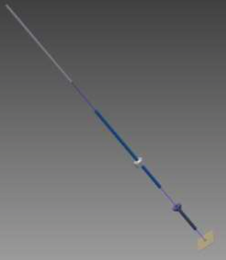
Components of DranaPerk
Exploded view of DranaPerk System
DranaPerk • A Bag Delivery System for Contained Laparoscopic Power Morcellation

Slide 6
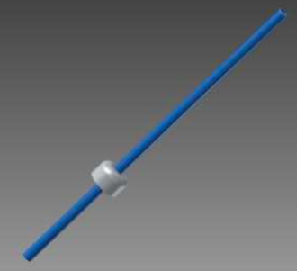
The Tube and Joint
Dimensions:
Tube:
do = 14.5 mm
di = 13.0 mm
L = 500 mm
Joint:
(at 35.5 cm from top)
do = 49.0 mm
di = 13.0 mm
L = 30 mm
DranaPerk • A Bag Delivery System for Contained Laparoscopic Power Morcellation

Slide 7
Tube: Necessary Stresses and Forces
PVC Analog
DranaPerk • A Bag Delivery System for Contained Laparoscopic Power Morcellation

Slide 8
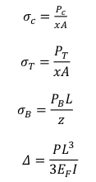
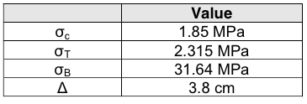
Tube: Necessary Stresses and Forces
PVC Analog
DranaPerk • A Bag Delivery System for Contained Laparoscopic Power Morcellation

Slide 9
Selected Material
Handbook of Polymer Applications in Medicine and Medical Devices
Mechanical Properties of Potential Materials
DranaPerk • A Bag Delivery System for Contained Laparoscopic Power Morcellation

Slide 10
Selected Material
Pugh Chart
Selected Material = Zelux GS Polycarbonate
DranaPerk • A Bag Delivery System for Contained Laparoscopic Power Morcellation

Slide 11
Selected Material
Zelux GS Polycarbonate Comparison
 | PVC Analog | Zelux GS
Tensile Strength | 2.315 MPa | 57.92 MPa
Compressive Strength | 1.85 MPa | 86.18 MPa
Deflection | 3.8 cm | 0.92 cm
Mass = (density)(volume) = 299 g
DranaPerk • A Bag Delivery System for Contained Laparoscopic Power Morcellation

Slide 12
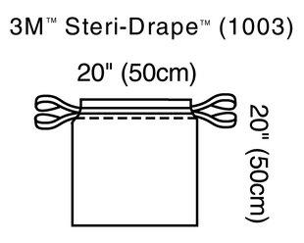
Bag Design
Analog:
Dimensions:
Area: 50cm X 50cm
Thickness: 30 um
Used by client at Barnes-Jewish Hospital
DranaPerk • A Bag Delivery System for Contained Laparoscopic Power Morcellation

Slide 13
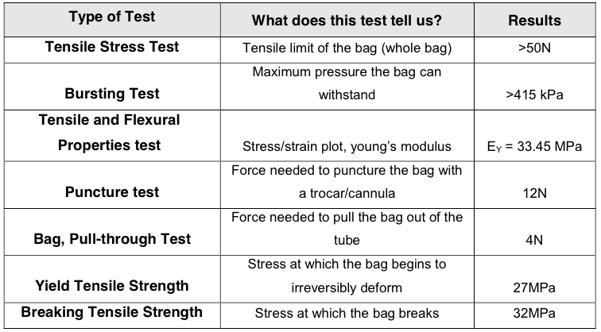
Bag Testing
Current Bag Properties
DranaPerk • A Bag Delivery System for Contained Laparoscopic Power Morcellation

Slide 14
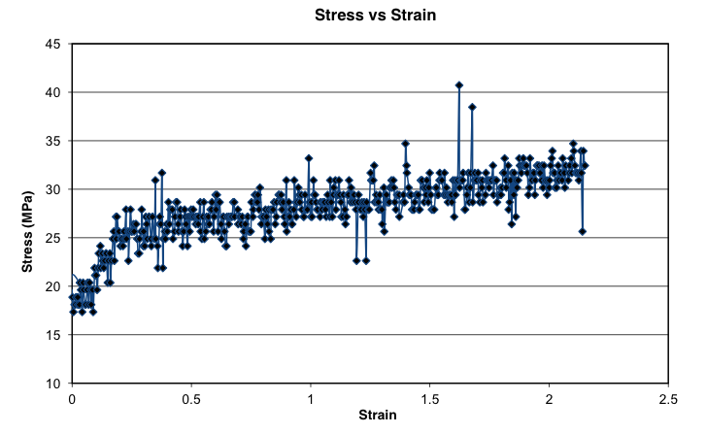
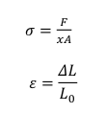
Bag Testing
DranaPerk • A Bag Delivery System for Contained Laparoscopic Power Morcellation

Slide 15
Chosen Bag Material
Mechanical Properties of Chosen Bag Material
Comparison of Mechanical Properties
 | Steri-Drape Analog | NOVAPOL HF Y450-A
Youngs Modulus | 35.45 MPa | 1.38 GPa
Yield Tensile Strength | 27 MPa | 22 MPa
Compressive Strength | 32 MPa | 35 MPa
Weight = (density)(volume) = 3.84 g
DranaPerk • A Bag Delivery System for Contained Laparoscopic Power Morcellation

Slide 16
Bag Design
DranaPerk Bag
Dimensions:
Area: 50cm X 50cm
Four colored tabs at corners
Structural Weaknesses
Yellow Striping
DranaPerk • A Bag Delivery System for Contained Laparoscopic Power Morcellation

Slide 17
Drawstring
Designed to be woven through the top of the bag to synch the bag closed
Must withstand:
Weight of bag + Morcellated Specimen
DranaPerk • A Bag Delivery System for Contained Laparoscopic Power Morcellation

Slide 18
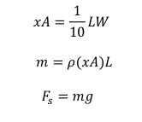
Drawstring: Calculations
Cross sectional area (xA), mass, and weight calculations:
DranaPerk • A Bag Delivery System for Contained Laparoscopic Power Morcellation

Slide 19
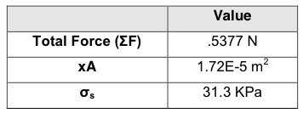
Drawstring: Calculations
Estimated weight of specimen:
Max: 50 g or 0.5 N
DranaPerk • A Bag Delivery System for Contained Laparoscopic Power Morcellation

Slide 20
Drawstring: Chosen Material
Chosen Drawstring Material: PRL Nylon 6,6 EX1
Mechanical Properties of PRL Nylon 6,6 EX1
Yield Strength is much larger than 31.1 kPa
DranaPerk • A Bag Delivery System for Contained Laparoscopic Power Morcellation

Slide 21
Manufacturing: Tube and Joint
Material: Zelux GS Polycarbonate
Manufacturer: Visipak
Process:
Injection molding of medical grade, gamma stabilized Zelux GS resin into mold with the same dimensions of tube and joint. Material will be hardened and removed from mold.
Tube and joint components will be sterilized using ethylene oxide sterilization techniques
Lead Time: 8-10 weeks
Price per Tube and Joint: $ 4.95
DranaPerk • A Bag Delivery System for Contained Laparoscopic Power Morcellation

Slide 22
Manufacturing: Bag
Material: NOVAPOL HF-Y450-A
Manufacturer: Grainger (Tough Guy Hospital Isolation Bag)
Process:
Melt pellets of NOVAPOL HG-Y450-A resin are melted and extruded into a bubble shape. The bubble sides of the bubble are pressed together and flattened into a sheet, and then cooled. Then the sheets can be wound into rolls
Rolls can be printed with yellow stripes (4.95 mm wide) on lower third
Structural weaknesses can be cut 18 um into the bag in ‘X’ shape patterns every 2.5 cm (only for middle third)
Lead Time: 6-8 weeks
Price per Bag: $ 0.1335
DranaPerk • A Bag Delivery System for Contained Laparoscopic Power Morcellation

Slide 23
Manufacturing: String
Material: PRL Nylon 6,6
Manufacturer: Polymer Resources, Ltd.
Process:
PRL Nylon 6,6 EX1 pellets are melted and spun, then extruded into microfilaments.
The microfilaments will be woven into a 0.635cm x 0.1 cm x 102 cm string and dyed bright blue
String will be washed, sterilized, and inserted into the rim of the bag and fused together at ends
Lead Time: 6-8 weeks
Price per Drawstring: $ 1.38
DranaPerk • A Bag Delivery System for Contained Laparoscopic Power Morcellation

Slide 24
Conclusions:
Recap of Specifications:
Things to Consider: | Requirements
Material (Bag, Tube, and String) | Biocompatible, Non-toxic
Bag Size | Fit within the peritoneal cavity
Bag Deployment | Fit through a 15 mm trocar port
Tube Dimensions | Fit through a 15 mm trocar port
 | End must protrude from trocar opening
Cost | $7.25 + $60/min saved
Time | Must reduce surgical time by 2 min
DranaPerk • A Bag Delivery System for Contained Laparoscopic Power Morcellation

Slide 25
Conclusions:
Cost Comparison:
Price | Current System | DranaPerk
Bag | $ 7.25 | $ 0.1335
Tube and Joint | N/A | $ 4.95
Drawstring | N/A | $ 1.31
Total: | $ 7.25 | $ 6.39
DranaPerk • A Bag Delivery System for Contained Laparoscopic Power Morcellation

Slide 26
Conclusions:
Estimated Time Using Current Method:
10 - 35 min
Time Using DranaPerk:
Time to Deploy: 54 sec
Time to Unravel & Place Specimen: 40 sec
Time to Synch Drawstring and Prepare for Morcellation: 40 sec
Total Time: 2.23 min
Time Saved:
7.77 - 32.7 min OR $466.2 - $1962.0
DranaPerk • A Bag Delivery System for Contained Laparoscopic Power Morcellation

Slide 27
Thank You
Questions?
DranaPerk • A Bag Delivery System for Contained Laparoscopic Power Morcellation

Slide 28
References
[1] Cohen, Sarah L., et al. "Contained Power Morcellation within an Insufflated Isolation Bag." Obstetrics & Gynecology 124.3 (2014): 491-7. Print.
[2] BPL HDPE300. 2014 Bay Plastics Ltd. 22 Nov. 2014. http://www.bayplastics.co.uk/PDFs/datasheets/New%20Folder/HDPE300.pdf.
[3] NOVAPOL(R) HF-Y450-A Resin . 2014 NOVA Chemicals. 22 Nov.2014. http://www.novachem.com/Product%20Documents/NOVAPOLHF-Y450-A_DS_EN.pdf.
[4] Sinha, Rakesh, Meenakshi Sundaram, Smita Lakhotia, Chaitali Mahajan, Gayatri Manaktala, and Parul Shah. "Total Laparoscopic Hysterectomy for Large Uterus.” Journal of Gynecological Endoscopy and Surgery 1 to 2 (2009): 34. Web.
[5] Hibbeler, R.C. “Steel in Tension, Compression and Shear.” Journal of the Franklin Institute 189.5 (1920): 691-92. Prentice Hall; 13 Edition. Web. 20 Nov. 2014. <https://notendur.hi.is/mvg1/ch1-1.pdf>.
[6] Sidner, Arthur E. "Sample Pages from FDG." Advanced Technical Communications LLC. N.p., n.d. Web. 16 Nov. 2014.
[7] "Polycarbonates." Polymer Science Learning Center - Departnment of Polymer Science. University of Southern Mississippi, 1 Jan. 2005. Web. 20 Nov. 2014. <http://pslc.ws/macrog/pc.htm>.
[8] "Zelux® GS Polycarbonate - Gamma Stabilized." Westlake Plastics - Life in Polymers. Westlake Plastics, 1 Jan. 2014. Web. 21 Nov. 2014. <http://www.westlakeplastics.com/product.php?c=MD&n=60>.
[9] "Volume of a Tube." Quandaries and Queries. Math Central. Web. 24 Nov. 2014.
[10] "Hospital Isolation Bag." Grainger. N.p., n.d. Web. 22 Nov. 2014.
[11] "Physical Properties of LLDPE." Prime Polymer Co., Ltd. N.p., n.d. Web. 22 Nov. 2014.
[12] "Polythene (polyethylene):Properties, Production & Uses." Chemistry Tutorial : Production, Properties and Uses of Polyethylene. N.p., n.d. Web. 22 Nov. 2014.
[13] Schezny, John. "Choosing Device Materials." Telephone interview. 27 Nov. 2014.
[14] Madjarrad, K., and S. Ebnesajjad. "Plastics Used in Medical Devises.” Handbook of Polymer Applications in Medicine and Medical Devices. 1st ed. Vol. 1. Elsevier, 2013. 368. Print.
.
DranaPerk • A Bag Delivery System for Contained Laparoscopic Power Morcellation

Slide 29
References
[15] "KETRON® PEEK LSG Specifications." Boedeker Plastics : KETRON PEEK LSG Datasheet. 1 Jan. 2014. Web. 22 Nov. 2014. <http://www.boedeker.com/peeklsg.htm>
[16] 304L (S30403) "Flat Products Stainless Steel Grade Sheet." North American Stainless. Web. 18 Nov. 2014.
[17] "5/8" X 6' Extra Heavy Wall Round Clear Plastic Tube." VisiPak. 1 Jan. 2014. Web. 21 Nov. 2014. <http://store.visipak.com/5-8-x-6-Extra-Heavy-Wall-Round- Clear-Plastic-Tube-421355.html>.
[18] "Ketron® PEEK – Rod and Sheet" Ketron® PEEK Online. Professional Plastics, 1 Jan. 2014. Web. 22 Nov. 2014. <http://www.professionalplastics.com/KetronPEEK-Quadrant>.
[19] T4R58065 "Stainless Round Tube." MetalsDepot®. 1 Jan. 2014. Web. 21 Nov. 2014. <http://www.metalsdepot.com/products/stainless2.phtml?page=stainless roundtube&LimAcc= &aident>.
20] Gerbig, Steve. "Polyamide Moisture Absorption | Relative Dimensional Change of Various Nylon Products." Prospector. N.p., n.d. Web. 23 Nov. 2014.
[21] PRL NY66-EX1. 2014 Polymer Resources Ltd. 22 Nov. 2014. http://catalog.ides.com/Datasheet.aspx?I=73811&U=1&CULTURE=en- US&E=107341.
[22] "Engineering Materials." The Engineering ToolBox. N.p., n.d. Web. 23 Nov. 2014.
[23] "Plastic Extrusion and Manufacturing Process." Richmond Plastics. N.p., n.d. Web. 22 Nov. 2014.
[24] Anim, J., and S. Hentges. "Polycarbonate Safety in Medical Applications." Prospector. 20 May 2013. Web. 17 Nov. 2014.
[25] "Polyester Filament Yarn, Fiber and Spun from Quality Sources." SwicoFil. N.p., n.d. Web. 23 Nov. 2014
.
DranaPerk • A Bag Delivery System for Contained Laparoscopic Power Morcellation

