Slide 1
Contained Laparoscopic Morcellation System for Gynecological Surgery
Presented By: Dana Sprague

Slide 2
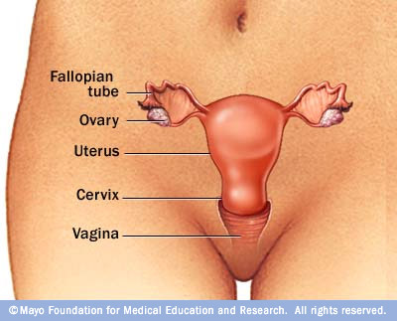
Background
Hysterectomy: surgical removal of the uterus
Myomectomy: surgical removal of uterine fibroids (leiomyomas)
3 modes of Hysterectomies:
Abdominal
Vaginal
Laparoscopic

Slide 3
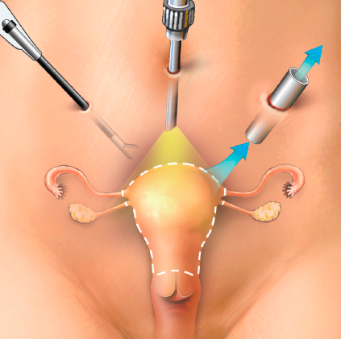
Laparoscopic Hysterectomy
Laparoscopic Hysterectomy
Traditionally, abdominal hysterectomies were favored
Now, vaginal hysterectomies are recommended but with certain caveats
Otherwise laparoscopic hysterectomies are performed
About 11% of hysterectomies are laparoscopic, using a power morcellation system
Abdominal Hysterectomy (Laparotomy)

Slide 4
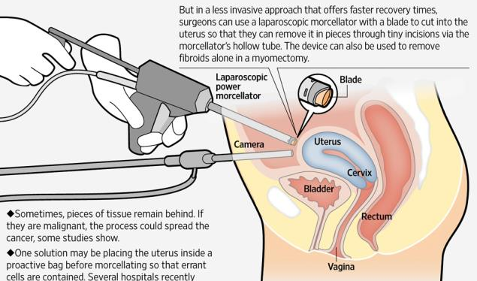
Laparoscopic Power Morcellation Systems
Morcellation systems lacerate the tissue
Tissue is then small enough to pull out through laparoscopic incisions
Pieces of tissue may be disseminated in the process of morcellation

Slide 5
Need for Contained Laparoscopic Morcellation Systems
Power morcellation can spread undiagnosed cancer
Risk of this happening is 1 in 350 women
Ability to contain the specimen is a large safety issue
Difficult to incorporate a containment technique in a timely fashion
A containment device is needed that:
Can be inserted and removed through laparoscopic incisions
Will not tear or rip when when coming in contact with morcellator

Slide 6
Project Scope
The goal is to design a containment bag that:
decreases overall surgery time by 2 min
Increases durability and resistance to puncture from the morcellator
Containment process takes an extra 10min - 30min of surgery time
Therefore it will be most advantageous to focus on bag deployment efficiency

Slide 7
Specifications
Bag must be safe for the patients
Non-toxic, biocompatible, sterile
Bag deployment must not injure the patient
No sharp or protruding pieces
The bag must be flexible
Should not cause any extra internal bleeding
Waterproof and durable/resistant to puncture from morcellator
Bag may have several layers – 1 durable layer
Number, size and placement of incisions will not change
The bag will fit through a 12mm trocar
Appropriate size to fit in a woman’s abdomen
Between 20cm x 50cm on each side
Priced competitively to existing bags
Current bags: $2 - $30
Each minute in the OR: $60 - $100
$Bag = (current bag price) + ($60)*each minute saved in the OR

Slide 8
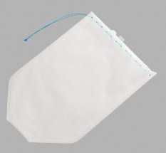
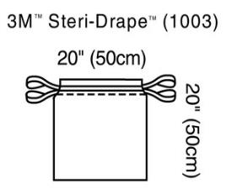
Existing Solutions
Figure 3: Cook Medical LapSac®
Currently, containment is performed with insufflation isolation bags
Transparent, cheap
Manually positioned around the specimen
Only FDA approved bag
Cook Medical LapSac®
General use bag:
3M™ Steri-Drape™ Isolation Bag 1003
Bag used in the video
3M™ Steri-Drape™ Isolation Bag 1003

Slide 9
Patent
Surgical Bag
Surgical bag has 3 layers
First and third layers are nonconductive
Second layer is electrically conductive
If morcellator comes in contact with 2nd layer, power will be killed to the morcellator
Zoomed view of 3 layered bag
Overview of circuit

Slide 10
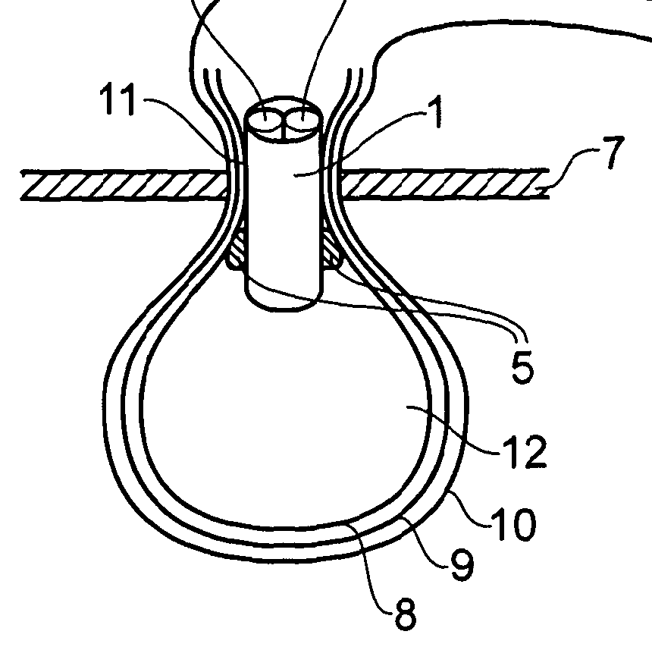
Patent
Composed of 3 layers
Inner waterproof layer
Morcellation-resistant middle layer
Waterproof outer layer
Contains:
Port for tubing
Nozzle for insufflation
Inflatable cuff for water-tight seal

Slide 11
Other Technologies
Actuated wire-mesh and bag morcellation device
Contains a wire mesh enclosed by a bag
the mesh compresses and morcellates the tissue
Both can be pulled out using deployer handle
Has not yet been released to market

Slide 12
Preliminary Design Schedule

Slide 13
Organization of Team Responsibilities
Dana Sprague – Will research material properties for the construction of the bag
Michael (Drew) Barron – will research bag deployment ideas and techniques
Braden Perkins – Will research bag features
Weekly Meetings
Weekly Check-ups with client

Slide 14
References
"AAGL Practice Report: Morcellation during Uterine Tissue Extraction." Journal of Minimally Invasive Gynecology 21.4 (2014): 517-30. Print.
Cohen, Sarah L., et al. "Contained Power Morcellation within an Insufflated Isolation Bag." Obstetrics & Gynecology 124.3 (2014): 491-7. Print.
Collins, Justin. Medical Device: Laparoscopic Bag. Ashford & St. Peter's Hospitals Chertsey, Surrey, assignee. Patent 20140135788 A1. 15 May 2014. Print.
Einarsson, Jon I., et al. "In-Bag Morcellation." Journal of Minimally Invasive Gynecology 21.5 (2014): 951-3. Print.
Isakov, Alexander, et al. “A New Laparoscopic Morcellator Using an Actuated Wire Mesh and Bag” J. Med. Devices 8, 011009 (2014) (7 pages); Paper No: MED-13-1126; Web.
Levits, Jenifer, and John Kamp. "How Morcellators Simplified the Hysterectomy but Posed a Hidden Cancer Risk." 11 April 2014 2014.Web. <http://online.wsj.com/news/articles/SB10001424052702304432604579473362527708066>.
Pagedas, Anthony C. Surgical Bag and Morcellator System and Method of Use. Ryan Kromholz & Manion, S.C., assignee. Patent 20070135780 A1. 14 June 2007. Print.
"Power Morcellation and Occult Malignancy in Gynecologic Surgery." The American College of Obstetricians and Gynecologists (2014): 1-6. Print.
Trucillo, Mario. Power Morcellator. American Recall Center, August 4, 2014. Web. 21 March 2014.
"3M™ Steri-Drape™ Isolation Bag 1003." 3M Infection Prevention. 2014.Web. <http://solutions.3m.com/wps/portal/3M/en_US/IPD-NA/3M-Infection-Prevention/products/catalog/~/3M-Steri-Drape-Isolation-Bag-1003?N=4294957758+5604328&rt=d>.
Wolfe, Morgan. Personal interview. 29 Aug. 2014.

Slide 15
Questions?

