Slide 1
Contained Laparoscopic Morcellation System for Gynecological Surgery
Presented By: Michael Barron

Slide 2
Uncontained Morcellation Procedure
Separate uterus/fibroid from attachments
Cut into small pieces (morcellation)
Pull pieces out of abdomen

Slide 3
Need for Contained Laparoscopic Morcellation Systems
Uncontained power morcellation can spread undiagnosed cancer
The alternative is contained power morcellation using an isolation bag
Currently, establishing containment with a bag is frustrating and time consuming
A containment device is needed that:
Can insert the isolation bag through laparoscopic incisions
Will reduce the hassle and time used to deploy the bag
Will endure contact with laparoscopic graspers/endoscope during surgery

Slide 4
Project Scope
The goal is to design a containment system that decreases overall surgery time by 2 min
Currently, establishing containment can take an extra 10min - 30min of surgery time
Increasing the efficiency of this process by reducing deployment time would reduce surgical costs as well as infection risk to the patient

Slide 5
Specifications
Bag must be safe for the patients
Bag deployment must not injure the patient
Waterproof and durable
Needs to withstand contact with laparoscopic graspers and endoscopes
Number, size and placement of incisions will not change
The bag will fit through a 15mm trocar
Appropriate deployment size to fit in the abdominal cavity.
Priced competitively to existing bags
Current bags: $2 - $30
Each minute in the OR: $60 - $100
Maximum bag price= (current bag price) + ($60)*each minute saved in the OR

Slide 6
Our Design
Our design will address the following 3 issues:
Bag deployment method
The containment bag itself
Creating a “port” for the side trocar to access

Slide 7
Bag Deployment Designs
One aspect of our design is how to deploy the containment bag
Needs to place the bag inside the abdomen in a timely manner
Bag must be able of passing though the 15mm tocar in the umbilical port
Must not cause any injury to the patient
Should be relatively easy for the surgeon to use
Here are some examples:

Slide 8
Tube with Plunger
3 component system
Rigid Tube, Bag, and Plunger
Bag is tightly pre-rolled into a cylindrical shape that is located inside the rigid tube
During operation, the front end of the tube is matched with the 15mm trocar in the umbilical port
Surgeon uses plunger to push bag into abdomen

Slide 9
Trigger Mechanism
Reusable handle with trigger mechanism
Disposable rod and bag
Trigger is attached to wiring, which runs the length of the tube and into the opening rim of the bag
Activating the trigger will push some of the wire, and thus the bag, out of the tube
This will expand and open the bag
Deactivating the trigger will pull the wire back into the tube, drawing the bag closed.

Slide 10
Lubricated Bag
Apply biologically compatible lubricant to either the inside of the trocar or the outside of the isolation bag
Roll the bag into a cylindrical shape
Push through the trocar (method current in use)
The reduction in friction between the outside of the bag and the inside surface of the trocar should allow the bag to pass through more easily

Slide 11
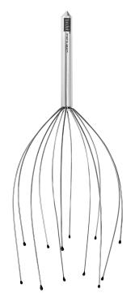
Hollow Ribbing with Wire
2 parts:
Bag with hollow ribbing (5-10 ribs)
Reusable wire device
Wires from the wire device insert into the hollow ribbing. This:
Compresses bag into tight, cylindrical shape
Provides rigidity to bag
Use wire device to push bag into abdomen through trocar, then pull the wires out, leaving only the bag in the abdomen

Slide 12
Hollow Ribbing with Air
Similar to above
Provide rigidity to ribbing with compressed air instead of wire
Single port in rim of bag connects to each rib
Pumping compressed air into the port fills the ribs, providing rigidity to the bag
Open port once bag is in the abdomen, letting the air out and making the bag more flexible

Slide 13
Containment Bag Designs
Another aspect of our design is what features to include in the containment bag itself
Should allow the surgeon to better manipulate the bag once within the patient’s abdomen
Must not cause any injury to the patient

Slide 14
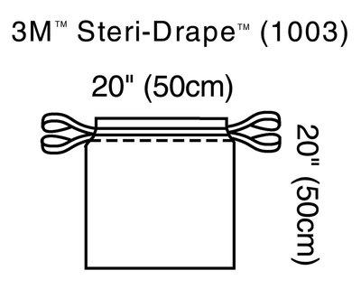

Slide 15
Colored Tabs
Place brightly colored tabs at the opening and corners of the bag
Corners will be colored differently than the ones at the opening
Allow quick recognition of the location of the bag by the surgeon
Provides additional location for the bag to be maneuvered by the surgeon using a grasper

Slide 16
Colored Bag
Apply a transparent color to the base of the bag
Could be striped or solid
Color helps identify where the base of the bag is to the surgeon
Transparency allows the surgeon to still see abdominal bleeding

Slide 17
Attached Plastic Ring
Traditional containment bags contain a synthetic drawstring along the rim to close the containment bag
Ends of drawstring are tied together
Surgeon pulls on drawstring with a grabbing tool
Slow and clumsy
Instead, attach a plastic ring to the ends of the drawstring
Allows the surgeon to hook the ring, and then pull the bag closed

Slide 18
Closed Loop Drawstring
Alternatively, have one continuous drawstring woven into the opening rim of the bag
Include multiple openings in the rim as access points
Grabbing just one of these openings would allow the surgeon to pull the bag closed

Slide 19
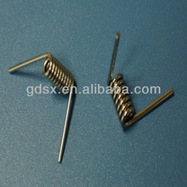
Spring-loaded Bag:
Include a torsion spring (hair-clip) attached to 2+ arms in the bag
Compress arms together
Insert through the trocar
Bag opens inside abdomen
Close bag later with drawstring

Slide 20
Side Trocar Access Port Designs
The final aspect of our design is how to facilitate side trocar access to the inside of a deployed containment bag
Should allow the surgeon to insert the side trocar into the containment bag more easily
Must keep escaped tissue at a minimum

Slide 21
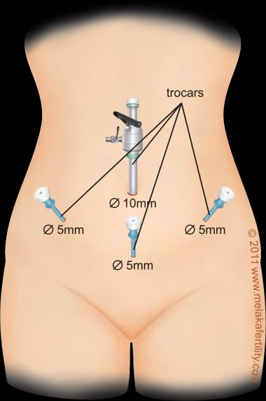

Slide 22
Pre-existing Ports
Could be either external or internal
Consists of an off-the-shelf pressure seal built into the lining of the bag and a positioning device
The positioning device enables the surgeon to maneuver the pressure seal next to the side trocar. It could be:
An elevated ring around the pressure seal, to be hooked by the surgeon
A string attached to the edge of the pressure seal

Slide 23
Built in Structural Weakness
Instead of including a specialized port, allows the surgeon to more easily puncture the bag with the side trocar (current method)
Sealed with a balloon-tipped cannula
On the side of the bag, slightly weaken the wall of the bag with:
Broad areas of slightly thinner wall
Multiple, cross-shaped indent arranged in a grid pattern

Slide 24
Final Design Analysis
Ultimately, we decided on:
A Tube with Plunger as our deployment system
A Closed Loop Drawstring method for closing the bag
Also will pursue colored tabs and bag
Structural weakness as our Port for Side Trocar Access

Slide 25
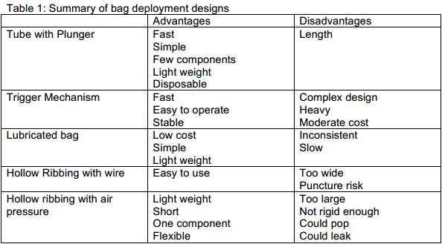
Bag Deployment Design Summary

Slide 26
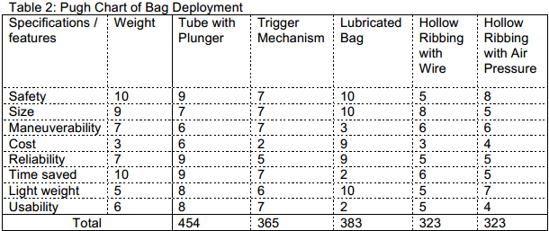
Pugh Chart of Bag Deployment Designs

Slide 27
Why we chose it: Tube with Plunger
Highest time-saved estimate of all deployment designs
Simple design
Reliable
Relatively lightweight
Usable

Slide 28
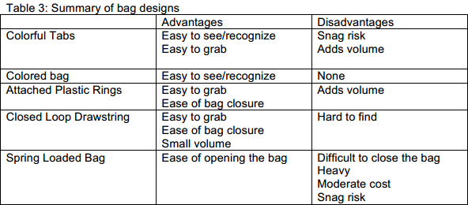
Containment Bag Design Summary

Slide 29
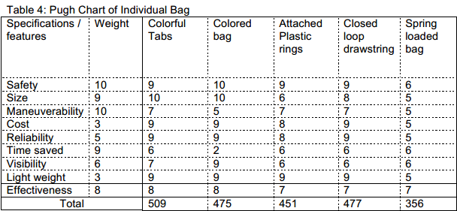
Pugh Chart of Containment Bag Designs

Slide 30
Why we chose it: Closed Loop Drawstring
More accessible
Leads to less maneuvering
Thus more time saved
Minimal space occupied

Slide 31
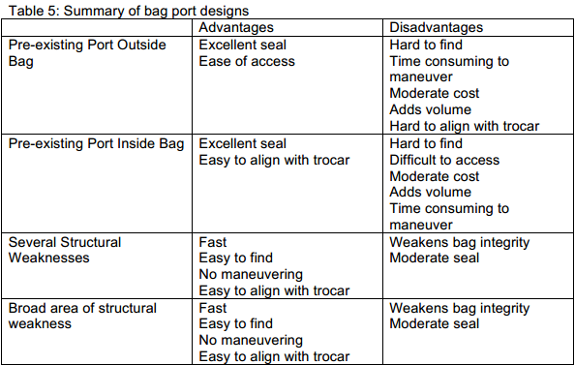
Ports for Side Trocar Access Design Summary

Slide 32
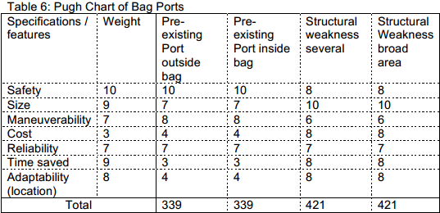
Pugh Chart of Ports for Side Trocar Access

Slide 33
Why we chose it: Structural Weakness
Easy to align with trocar
Little to none maneuvering necessary
No additional tools needed
Easy to find
Less force is needed to insert trocar into bag
Fast

Slide 34
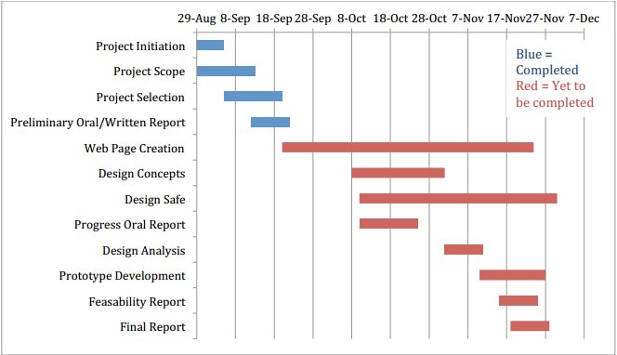
Preliminary Design Schedule

Slide 35
Organization of Team Responsibilities
Dana Sprague – Manages public relations and communication between the team and client
Michael Barron – Leads design generation and defining design specifications
Braden Perkins – Generates CAD sketches to aid with conceptual understanding during brainstorming sessions

Slide 36
References
"Power Morcellation and Occult Malignancy in Gynecologic Surgery." The American College of Obstetricians and Gynecologists (2014): 1-6. Print.
Einarsson, Jon I., et al. "In-Bag Morcellation." Journal of Minimally Invasive Gynecology 21.5 (2014): 951-3. Print.
“Head Scratcher.” Digital image. Bedol What’s Next. FlugelSoft. 2014. Web. 20 Oct. 2014
Wolfe, Morgan. Personal interview. 29 Aug. 2014, 1 Oct. 2014, 20 ct. 2014.
"Laparoscopy Surgery in Gynaecology." Melaka Fertility. Selva's Fertility, Obsterics & Gynaecology Clinic, n.d. Web. 26 Oct. 2014.
"Hair Clip Spring Supplier Torsion Spring Supplier In China Factory - Buy Hair Clip Spring Supplier Torsion Spring Supplier,Adjustable Torsion Springs,Torsion Spring Constant Product on Alibaba.com." Www.alibaba.com. N.p., n.d. Web. 26 Oct. 2014.
"3M™ Steri-Drape™ Isolation Bag 1003." 3M Infection Prevention. 2014.Web.<http://solutions.3m.com/wps/portal/3M/en_US/IPD-NA/3M-Infection-Prevention/products/catalog/~/3M-Steri-Drape-Isolation-Bag-1003?N=4294957758+5604328&rt=d

Slide 37
Questions?

